Slide 1
JAVA THREAD
SPECIAL JAVA SUBJECT

Slide 2
Objective
Process and Thread
What is a thread
How to create threads in Java
The Life Cycle of a thread
Thread Priority
Synchronization of threads

Slide 3
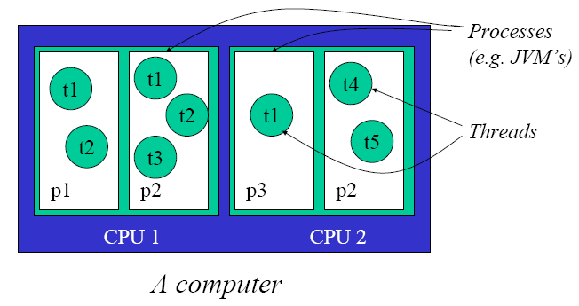
Processes and Threads

Slide 4
Processes vs. Threads

Slide 5
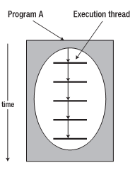
A single threaded program
class ABC
{
….
public void main(..)
{
…
..
}
}
begin
Body
end

Slide 6
A Multithreaded Program
Main Thread
start
start
start
Thread A
Thread B
Thread C

Slide 7
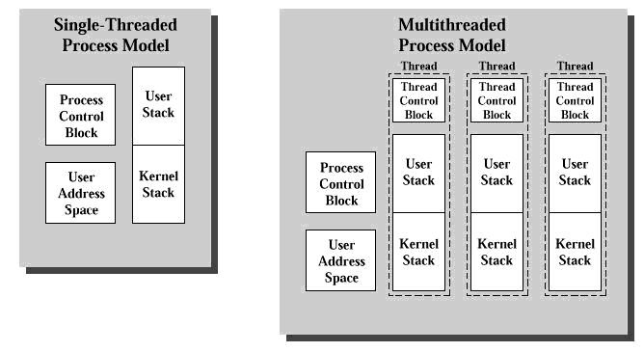
Understanding Threads

Slide 8
Multi-Thread vs. Multi-Process
Less time to create a new thread than a process
Less time to terminate a thread than a process.
Less time to switch between two threads within the same process
Less communication overheads

Slide 9
Web/Internet Applications: Serving Many Users Simultaneously
PC client
Internet Server
Local Area Network
PDA

Slide 10
Multithreaded Server: For Serving Multiple Clients Concurrently
Client 1 Process
Server Process
Server
Threads
Internet
Client 2 Process

Slide 11
What Is a Thread
A thread is a lightweight process – a single sequentialflow of execution within a program
Threads make possible the implementation of programs that seem to perform multiple tasks at the same time (e.g. multi-threaded Web servers)
A new way to think about programming
Multithreading has several advantages over Multiprocessing such as:
Threads are lightweight compared to processes
Threads share the same address space and therefore can share both data and code
Context switching between threads is usually less expensive than between processes
Cost of thread intercommunication is relatively low that that of process intercommunication
Threads allow different tasks to be performed concurrently.

Slide 12
Understanding Threads
A non-multithreaded program has one thread of execution, called the main thread.
In a multithreaded program, you can spawn other threads in addition to the main thread
You can write a thread class in one of two ways:
Extend the Thread class
Implement the Runnable interface

Slide 13
Thread creation
There are two ways to create a Java thread:
1. Extend the java.lang.Thread class
2. Implement the java.lang.Runnable interface
Overriding run method

Slide 14
Extending the Thread class
In order to create a new thread we may subclass java.lang.Thread and customize what the thread does by overriding its empty run method.
The run method is where the action of the thread takes place.
The execution of a thread starts by calling the start method.

Slide 15
Subclassing Thread and Overriding run
public class SimpleThread extends Thread {
public SimpleThread(String str) { super(str); }
public void run() {
for (int i = 0; i < 10; i++) {
System.out.format("%d %s%n", i, getName());
try {
sleep((long)(Math.random() * 1000));
} catch (InterruptedException e) {}
}
System.out.format("DONE! %s%n", getName());
}
}
public class TwoThreadsTest {
public static void main (String[] args) {
new SimpleThread("Jamaica").start();
new SimpleThread("Fiji").start();
}}

Slide 16
Implementing the Runnable interface
In order to create a new thread we may also provide a class that implements the java.lang.Runnable interface
Preffered way in case our class has to subclass some other class
A Runnable object can be wrapped up into a Thread object
– Thread(Runnable target)
– Thread(Runnable target, String name)
The thread’s logic is included inside the run method of the runnable object

Slide 17
Implementing the Runnable Interface
public class SimpleThread implements Runnable {
private String name;
public SimpleThread(String str) { this.name = str; }
public String getName() { return name; }
public void run() {
for (int i = 0; i < 10; i++) {
System.out.format("%d %s%n", i, getName());
try {
Thread.sleep((long)(Math.random() * 1000));
} catch (InterruptedException e) {}
}
System.out.format("DONE! %s%n", getName());
}}
public class TwoThreadsTest {
public static void main (String[] args) {
new Thread(new SimpleThread("Jamaica")).start();
new Thread(new SimpleThread("Fiji")).start();
}}

Slide 18
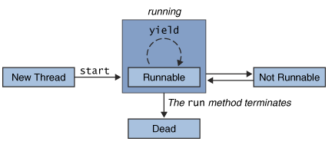
Thread States

Slide 19
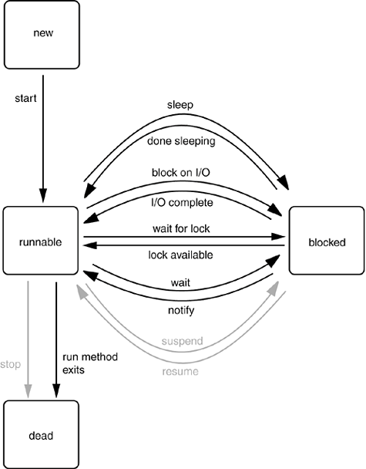
Thread States and Transitions

Slide 20
Thread Lifecycle
New: created but not yet started
Runnable: either running, or able to run on a free CPU
Blocked: waiting for I/O or on a lock
Sleeping: paused for a user-specified specified interval
Waiting: when the object on which it’s running invokes the wait() method. A call to notify() or notifyAll() (by another thread) will bring it back to the runnable state.
Dead: the normal end of Thread

Slide 21
Thread priority
On a single CPU threads actually run one at a time in such a way as to provide an illusion of concurrency.
Execution of multiple threads on a single CPU, in some order, is called scheduling.
The Java runtime supports a very simple scheduling algorithm (fixed priority scheduling). This algorithm schedules threads based on their priority relative to other runnable threads.

Slide 22
Thread priority
When a Java thread is created, it inherits its priority from the thread that created it.
You can modify a thread's priority at any time after its creation using the setPriority method.
Thread priorities are integers ranging between MIN_PRIORITY and MAX_PRIORITY (constants defined in the Thread class). The higher the integer, the higher the priority.
Use priority only to affect scheduling policy for efficiency purposes.
Do not rely on thread priority for algorithm correctness.

Slide 23
Synchonization
In many cases concurrently running threads share data and must consider the state and activities of other threads.
If two threads can both execute a method that modifies the state of an object then the method should be declared to be synchronized, allowing only one thread to execute the method at a time.
If a class has at least one synchronized methods, each instance of it has a monitor. A monitor is an object that can block threads and notify them when it is available.

Slide 24
Synchronization and Locks
Only methods (or blocks) can be synchronized, not variables or classes.
Each object has just one lock.
Not all methods in a class need to be synchronized. A class can have both synchronized and non-synchronized methods.
If two threads are about to execute a synchronized method in a class, and both threads are using the same instance of the class to invoke the method, only one thread at a time will be able to execute the method. The other thread will need to wait until the first one finishes its method call.
If a class has both synchronized and non-synchronized methods, multiple threads can still access the class's non-synchronized methods! If you have methods that don't access the data you're trying to protect, then you don't need to synchronize them.

Slide 25
Synchronization and Locks
If a thread goes to sleep, it holds any locks it has—it doesn't release them.
A thread can acquire more than one lock. For example, a thread can enter a synchronized method, thus acquiring a lock, and then immediately invoke a synchronized method on a different object, thus acquiring that lock as well. As the stack unwinds, locks are released again. Also, if a thread acquires a lock and then attempts to call a synchronized method on that same object, no problem. The JVM knows that this thread already has the lock for this object, so the thread is free to call other synchronized methods on the same object, using the lock the thread already has.
You can synchronize a block of code rather than a method.

Slide 26
Multi-Thread Programming Models
Consumer
Producer
R/W
Buffer
R/W

Slide 27
Synchronization and Locks in Concurrent Access
Concurrent Access problem
Method
counter++
Thread 1
execute
Thread 2
execute
1. Read the instance variable counter
2. Increment counter by one
3. Return counter

Slide 28
Object Locks
Java includes the concept of the monitor
The monitor controls access to a Java object
Access to portions of the object code may be made mutually exclusive by using the keyword synchronized
When a thread seeks access to a synchronized piece of code in a Java object, the monitor provides the access by providing a lock
That object holds the lock until it has finished executing the synchronized piece of code

Slide 29
Object Locks (cont.)
The synchronization may be implemented on the code or on the whole method
public class Tracker {
private int counter=0;
public synchronized int nextCounter()
{
return counter++;
}
}
Method Synchronization

Slide 30
Object Locks (cont.)
public class Tracker {
private int counter=0;
public int nextCounter() {
synchronized (this) {
return counter++;
}
}
}
Object Clock

Slide 31
Class Locks
If you change the value of a static variable in one object, the change will be visible to all other objects as well
Therefore, the object lock will not do the job for static variables
class GlobalTracker {
static count = 0;
public static synchronized int counter() {
return count++;
}
}

Slide 32
Class Locks (cont.)
class GlobalTracker {
static count = 0;
public static synchronized int counter() {
// code
synchronized(GlobalTracker.class) {
return count++;
}
// Some more code
}

Slide 33
Monitoring the Wait State
class CouponMachine {
private int couponID;
private boolean couponExists = false;
public synchronized void createCoupon(int coup) {
while(couponExists) {
try {
wait();
} catch (Exception e) {
System.out.println("Exception: " + e);
}
}
this.couponID = coup;
couponExists = true;
notify();
}

Slide 34
Monitoring the Wait State (cont.)
public synchronized int consumeCoupon() {
while(!couponExists) {
try {
wait();
} catch (Exception e) {
System.out.println("Exception: " + e);
}
}
couponExists = false;
notify();
return couponID;
}
}

Slide 35
Monitoring the Wait State (cont.)
class Producer extends Thread {
int count =0;
CouponMachine cpm;
Producer(CouponMachine cpm) {
this.cpm = cpm;
}
public void run() {
for (int i=0; i<5; i++){
cpm.createCoupon(++count);
System.out.println("Coupon produced: " + count);
}
}
}

Slide 36
Monitoring the Wait State (cont.)
class Consumer extends Thread {
int count;
CouponMachine cpm;
Consumer (CouponMachine cpm) {
this.cpm = cpm;
}
public void run() {
count=cpm.consumeCoupon();
System.out.println("Coupon consumed: " + count);
}
}

Slide 37
Monitoring the Wait State (cont.)
public class TestCouponMachine {
public static void main(String[] args) {
//create the coupon machine.
CouponMachine cm = new CouponMachine();
Consumer[] con = new Consumer[5];
for (int i=0; i<5; i++) {
con[i] = new Consumer(cm);
con[i].start();
}
Producer prod = new Producer(cm);
prod.start();
System.out.println(“End main thread!");
}
}

Slide 38
Synchronization of Threads

Slide 39
Synchronization of Threads
wait( ) tells the calling thread to give up the monitor and go to sleep until some other thread enters the same monitor and calls notify( ).
notify( ) wakes up the first thread that called wait() on the same object.
notifyAll( ) wakes up all the threads that called wait( ) on the same object. The highest priority thread will run first.

Slide 40
The Producer/Consumer Example
public class CubbyHole {
private int contents;
// unsyc
public int get(int who) {
System.out.format("Consumer %d got: %d%n", who, contents);
return contents;
}
public void put(int who, int value) {
contents = value;
System.out.format("Producer %d put: %d%n", who, contents);
}
}

Slide 41
The Producer/Consumer Example
public class CubbyHole {
private int contents;
private boolean available = false;
public int get(int who) {
while (!available) {};
available = false;
System.out.format("Consumer %d got: %d%n", who, contents);
return contents;
}
public void put(int who, int value) {
while (available){};
available = true;
contents = value;
System.out.format("Producer %d put: %d%n", who, contents);
}
}

Slide 42
The Producer/Consumer Example
public class Consumer extends Thread {
private CubbyHole cubbyhole;
private int number;
public Consumer(CubbyHole c, int number) {
cubbyhole = c;
this.number = number;
}
public void run() {
int value = 0;
for (int i = 0; i < 10; i++) {
value = cubbyhole.get(number);
try {
sleep((int)(Math.random() * 100));
} catch (InterruptedException e) { }
}
}
}

Slide 43
The Producer/Consumer Example
public class Producer extends Thread {
private CubbyHole cubbyhole;
private int number;
public Producer(CubbyHole c, int number) {
cubbyhole = c;
this.number = number;
}
public void run() {
for (int i = 0; i < 10; i++) {
cubbyhole.put(number, i);
try {
sleep((int)(Math.random() * 100));
} catch (InterruptedException e) { }
}
}
}

Slide 44
Locking an Object
Within a program, the code segments that access the same object from separate, concurrent threads are called critical sections. A critical section can be a block or a method and is identified with the synchronized keyword. The Java platform associates a lock with every object and the lock is acquired when a critical section is entered.
public synchronized void put(int value) { //CubbyHole locked by the Producer. ... //CubbyHole unlocked by the Producer. }
public synchronized int get() { //CubbyHole locked by the Consumer. ... //CubbyHole unlocked by the Consumer. }

Slide 45
Example
public class Account {
private int balance = 50;
public int getBalance() {
return balance;
}
public void withdraw(int amount) {
try {
int a = balance;
Thread.sleep(20);
balance = a - amount;
} catch (InterruptedException e) {}
}
public void deposit(int amount) {
try {
int a = balance;
Thread.sleep(40);
balance = a + amount;
} catch (InterruptedException e) {}
}}

Slide 46
Example
public class TestCount {
private Account acc = new Account();
public TestCount(){
Runnable t1 = new Runnable(){
public void run() {
for (int i = 1; i < 10; i++)acc.deposit(100);
System.out.println("T1 done: "+acc.getBalance());
}
};
Runnable t2 = new Runnable(){
public void run() {
for (int i = 1; i<10; i++)acc.withdraw(100);
System.out.println("T2 done: "+acc.getBalance());
}
};
new Thread(t1).start();
new Thread(t2).start();
}
public static void main(String[] args) {
new TestCount();
}}

Slide 47
Synchronization
public void withdraw(int amount) {
synchronized (this){
int a = balance;
try {
Thread.sleep(20);
} catch (InterruptedException e) {}
balance = a - amount;
}
}
public synchronized void deposit(int amount) {
int a = balance;
try {
Thread.sleep(40);
} catch (InterruptedException e) {}
balance = a + amount;
}

Slide 48
Lock Objects
public class Account {
private Lock bankLock = new ReentrantLock();
………………….
public void withdraw(int amount) {
bankLock.lock();
try {
int a = balance;
Thread.sleep(20);
balance = a - amount;
} catch (InterruptedException e) {}
finally {
bankLock.unlock();
}
}
public void deposit(int amount) {
bankLock.lock();
try {
int a = balance;
Thread.sleep(40);
balance = a + amount;
} catch (InterruptedException e) {}
finally {
bankLock.unlock();
}
}

Slide 49
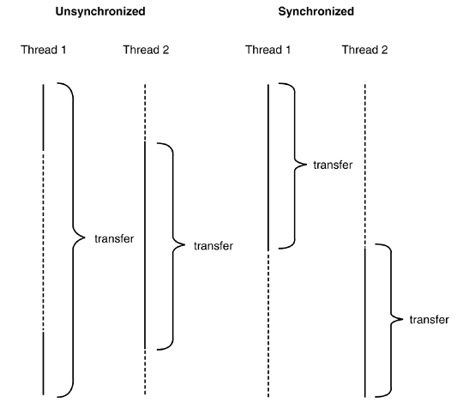
Comparison of unsynchronized and synchronized threads

Slide 50
Using the notifyAll and wait Methods
public synchronized int get() { //Won't work!
if (available == true) {
available = false;
return contents;
}
}
public synchronized void put(int value) { //Won't work!
if (available == false) {
available = true;
contents = value;
}
}

Slide 51
Using the notifyAll and wait Methods
public synchronized int get() {
while (available == false) {
try {
wait(); //Wait for Producer to put value.
} catch (InterruptedException e) { }
}
available = false;
notifyAll(); //Notify Producer that value has been retrieved.
return contents;
}
public synchronized void put(int value) {
while (available == true) {
try {
wait(); //Wait for Consumer to get value.
} catch (InterruptedException e) { }
}
contents = value;
available = true;
notifyAll(); //Notify Consumer that value has been set.
}

